Slide 1

Financial Performance Dashboard
-Presented by Taranjeet Kaur

Slide 2
Assignment Objective:
Comprehensive Analysis of Company’s performance across various departments .
(b) Identify Operational inefficiencies, opportunities for growth and provide actionable insights.
(c) Helping in Company’s growth and decision making .

Slide 3
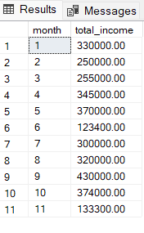
Business Request - 1
Calculate Income Earned in Each month in the financial year.
select Month(date) as month,
sum(amount) as total_income
from Income_data
group by MONTH(date)
order by month
Key Insights :-
Highest Income Month:
(a) September(Month 9) with Rs. 4,30,000.
(b) Followed by October(3,74,000) and May(3,70,000).
Lowest Income Month:
(a) June(Month 6) with Rs. 1,23,400.
(b) November(Month 11) is also low at Rs. 1,33,000.

Slide 4

Business Recommendations:
Focus on Off-Peak Months:
(a) Consistent high income from April to October and Sharp drop in June and again in November.
(b) Investigate why June and November are low-performing months, Look into seasonal and operations .
Forecasting and Planning:
(a) Use this monthly pattern to plan staffing, budgeting, and resource allocation.

Slide 5
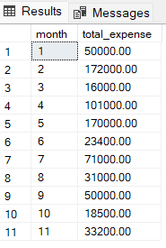
Business Request - 2
Calculate Expenses incurred in Each month in the financial year.
select Month(date) as month,
sum(amount) as total_expense
from expense_data
group by MONTH(date)
order by month
Key Insights :-
Highest Expense Month:
(a) February(Month 12) with Rs. 1,72,000 and May(Month 5)
with Rs. 1,70,000.
Lowest Expense Month:
(a) October(Month 10) with Rs. 18,500 and June(Month 6)
with Rs. 23,400
Overall Expense Trend:
(a) Generally Moderate or low expenses in high Income
months like October, September and August.

Slide 6

Sept, Oct, Aug, Jan, Mar: Low cost, high return
Business Recommendations:
Maximize Operations in Low Expense-High Income Months:
(a) Sept, Oct, March and Jan are low cost and high return months.
(b) These are most profitable months we should expand campaigns,
Staffing and Production .
Investigate High Expense Months (Feb, May):
(a) Expenses too High Compared to Income in these months.
(b) Analyze which Department caused spike.

Slide 7
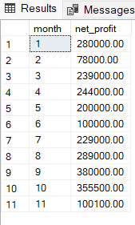
Business Request - 3
Calculate Net Profit Per Month.
select
i.month,
i.total_income - Coalesce(e.total_expense,0) as net_profit
from
(select Month(date) as month,sum(amount) as total_income
from Income_data
group by MONTH(date)) i
left join
(select Month(date) as month,sum(amount) as total_expense
from expense_data
group by MONTH(date)) e
on i.month = e.month
order by i.month
Key Insights :-
Most Profitable Months:
(a) Sept, Oct and Aug are the most profitable months, key
drivers of business Profitability.
Lowest Net profit Months:
(a) February’s profit was the lowest, mainly due to very high
expenses(1,72,000) relative to income(2,50,000).

Slide 8

Sept, Oct, Aug, Jan, Mar: Low cost, high return
Business Recommendations:
Maximize Peak Months:
(a) Boost Marketing and Sales in the months which show
strongest ROI.
(b) Plan Product Launches or events in these Months .
Future planning and Cost Control:
(a) Analyze February’s High cost reasons, review operations for
income improvement in future.
(b) Use the monthly Pattern for Budgeting, Planning and
Forecasting.

Slide 9
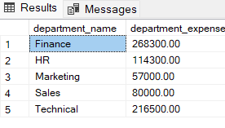
Business Request – 4
Calculate Expenses incurred by each department.
SELECT
d.department_name,
SUM(e.amount) AS department_expense
FROM expense_data e
JOIN departments d ON e.department_id = d.department_id
GROUP BY d.department_name
Key Insights :-
Top Spending Departments:
(a) Finance Department alone contributes approx. 35% of
total departmental expenses with Technical having
departmental expense of Rs. 2,16,500.
(b) Both these Departments contributes approx. 65% of
total expenses.
Least Spending Departments:
(a) Marketing(57,000) and Sales(80,000) have comparatively
lower departmental expense.

Slide 10

Sept, Oct, Aug, Jan, Mar: Low cost, high return
Business Recommendations:
Audit High Spending Departments:
(a) Especially Finance and Technical.
(b) Break down whether costs are fixed or variable, explore if some costs
can be optimized.
Empower Low Spending Departments:
(a) Evaluate if Marketing and Sales are underfunded.
(b) Reinvest some Budget into digital marketing or training to boost
revenue.

Slide 11
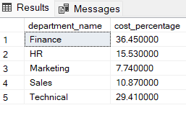
Business Request – 5
Calculate Department wise cost %.
SELECT
d.department_name,
ROUND(SUM(e.amount) * 100.0 / (SELECT SUM(amount) FROM expense_data), 2) AS cost_percentage
FROM expense_data e
JOIN departments d ON e.department_id = d.department_id
GROUP BY d.department_name

Slide 12
Secondary Analysis

Slide 13
Additional Data Collection for Enhanced Data-Driven Decisions:
Departmental Income Data:
(a) This Data would have helped in evaluating profitability per department .
(b) This would have helped in analyzing the performance and income generation of every department.
Client and Customers Data:
(a) This Data must have helped in concluding the highest contribution of clients and customers to which department, services and product .
(b) Which Departments, service and product is not performing well, helping in Churn Analysis.
Financial Statements:
(a) Income statement would include depreciation, taxes and interest helping in more accurate net profit and profitability analysis also showing how income and expenses affect financial position.
(b) Through financial statements, metrics like net profit margin, operating margin(DOL) or current ratio could have been calculated for better analysis.

Slide 14
THANK YOU!

